Slide 1
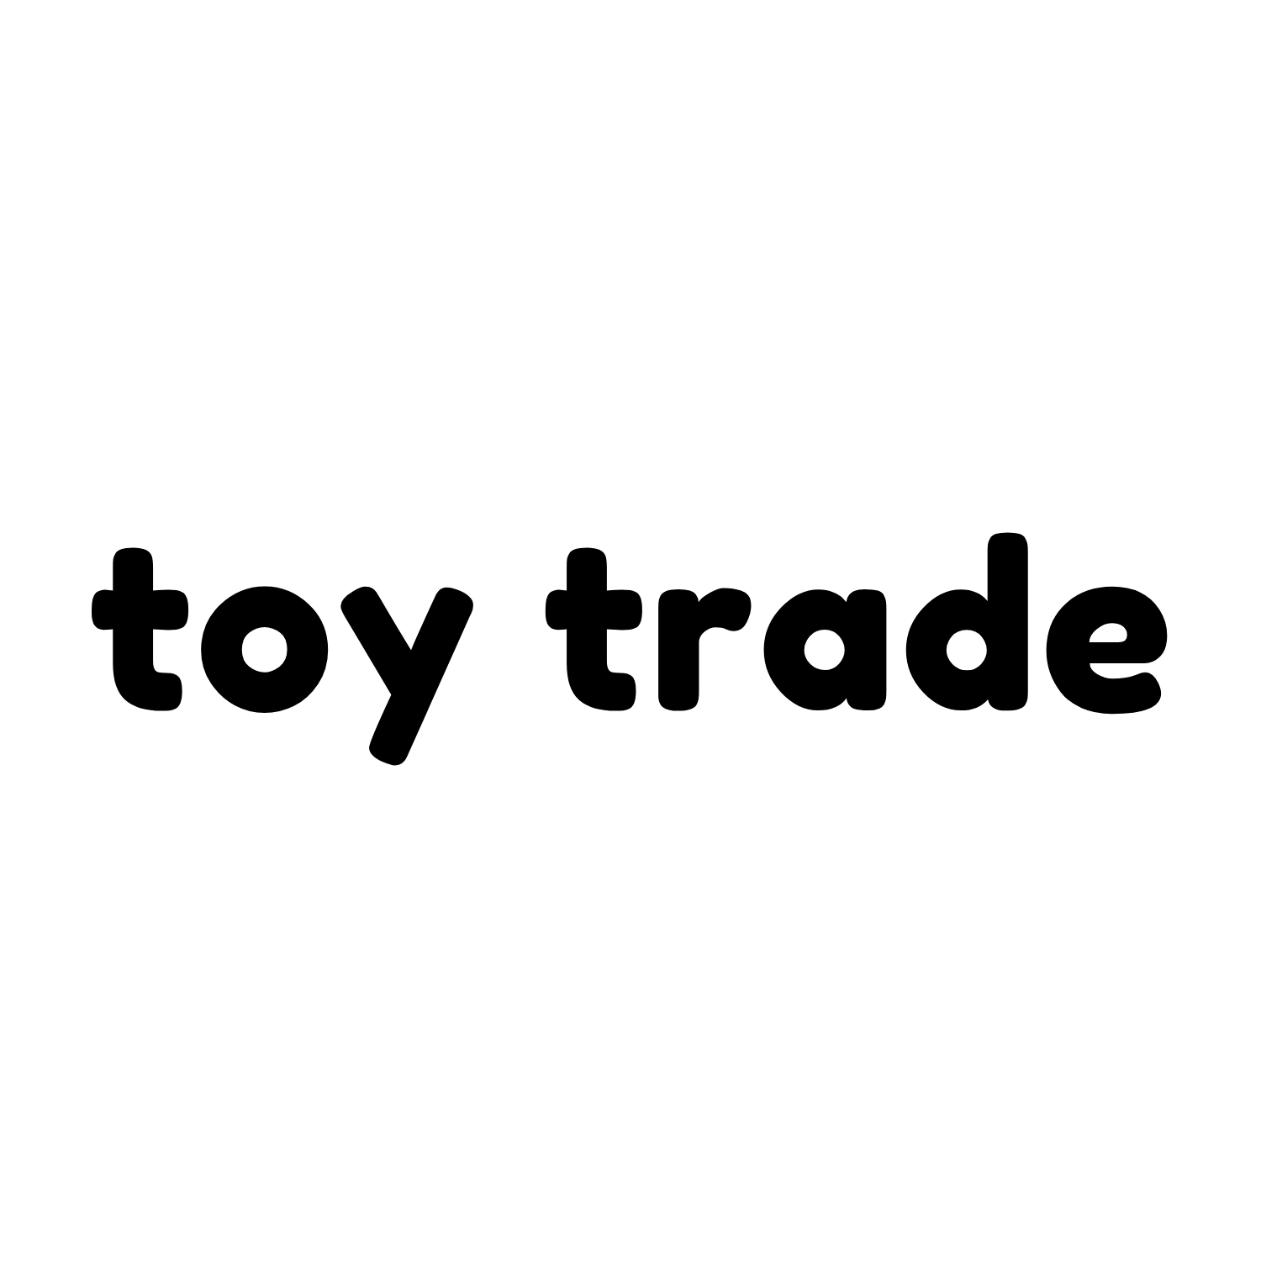
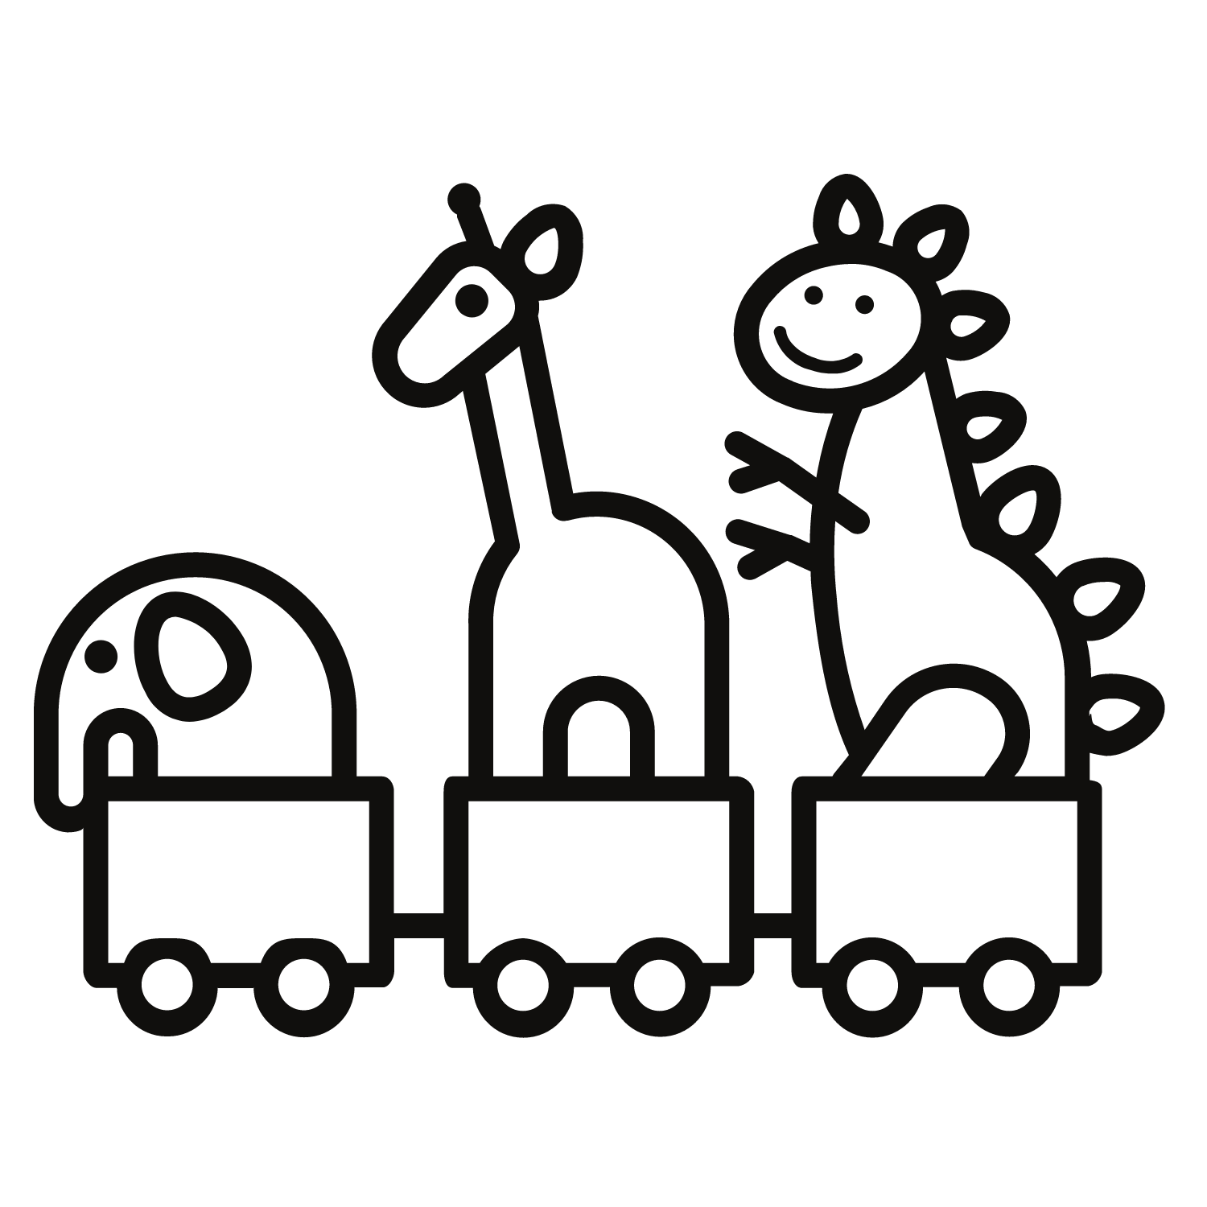
Colleen Corrigan, Joyce Fang, Tyler Green, Jody Sunray
Notes:
Colleen

Slide 2
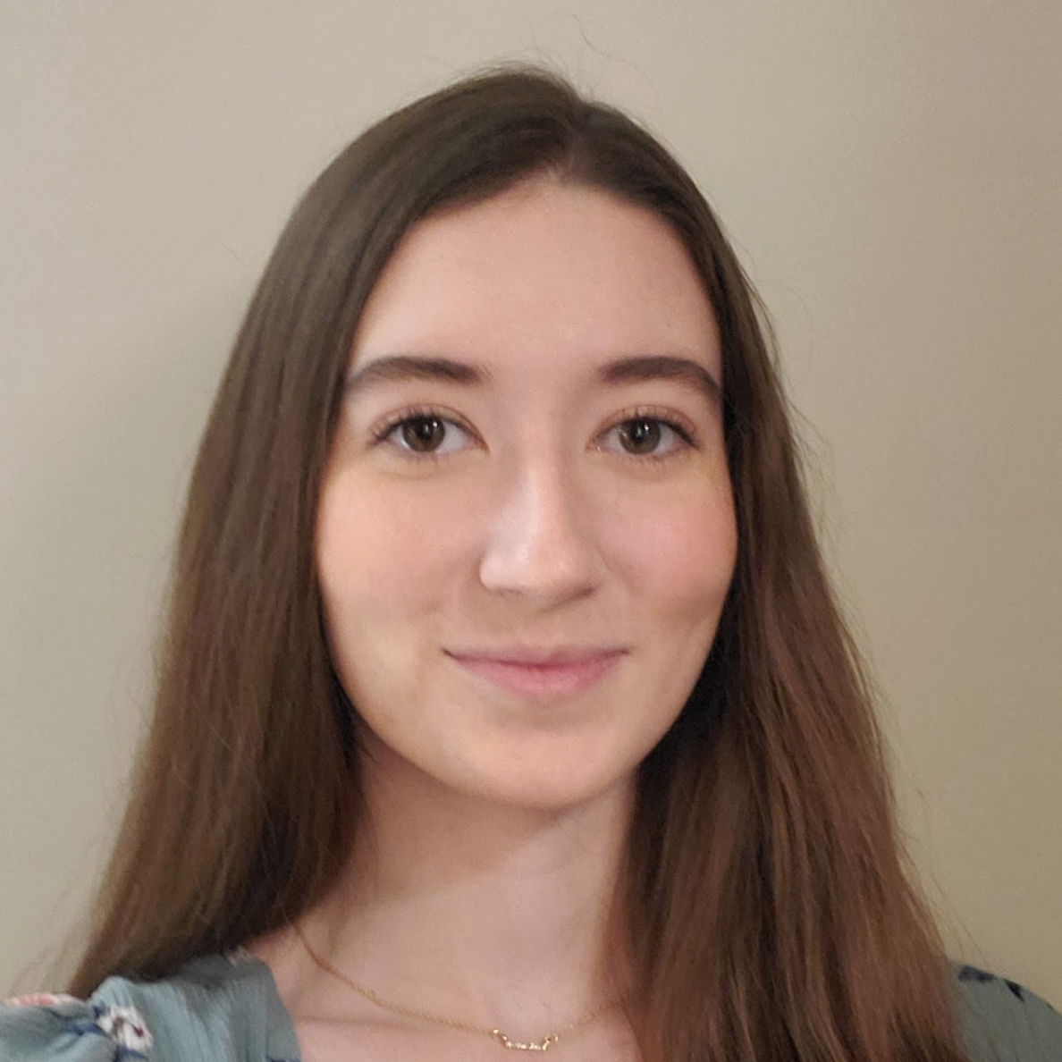
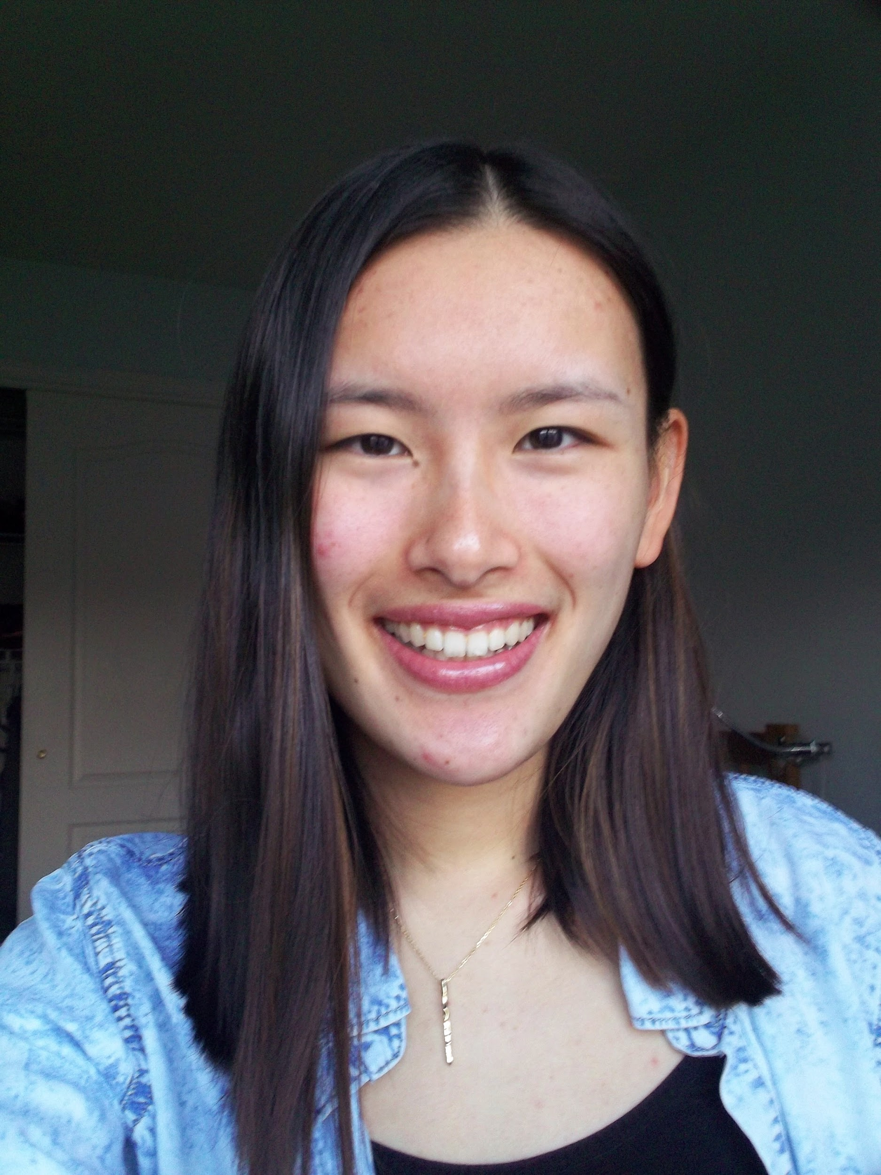


OUR TEAM
COLLEEN CORRIGAN
JOYCE FANG
Frontend Developer
Full-Stack Developer
TYLER GREEN
JODY SUNRAY
Frontend Developer
Full-Stack Developer
Notes:
All - Colleen, Joyce, Tyler, Jody
Make sure to say your major and concentration, class year, role in project, what you worked on

Slide 3
WHAT IS TOY TRADE?
Toy Trade is an application where users can browse toys that are available and coordinate exchanges with others
Users are able to set up their own profile along with a dashboard of all of the toys that they are willing to trade in
Our site features filtering, notification, and messaging systems
The exchange takes place at a neutral third party location such as a library or public school, coordinated by the two users involved
Notes:
Colleen

Slide 4
PROBLEM
Children can quickly become bored of toys
Toys can be expensive, and consistently replacing them can add financial stress for parents
Constantly buying new toys supports mass production, which is environmentally unfriendly
Many existing services are known for having unsafe methods of in person exchange
Notes:
Colleen

Slide 5
SOLUTION
Online service that connects two users in a safe and secure manner
Exchange is non-monetary, relies on two users finding a toy in each other’s listings to exchange
Chat feature allows users to work out details
Filtering to find the exact toy type, age range, or brand
Exchange is contactless in a third party location
Unique identifier is provided to ensure identification for pickup
Notes:
Colleen

Slide 6
STAKEHOLDERS
PARENTS
The average cost of a toy is about $14
Approx. 2 kids per family
$6,500 on toys per child before teens
MIDDLE MAN
Facilitate contactless exchange of toys
Connect with parents
CHILDREN
Gain almost the most value
Bored of old toys
Notes:
Tyler
-----This cost quickly adds up as according to, mother.ly, the average kid will have between 70 and 200 toys at any given age and the average parent will spend $6,500 on toys per child before they even reach their teens.
----According to another study, the less toys children have, the better their social skills become. With our app limiting the number of toys children have doesn’t have to be the only solution to bettering their social skills.

Slide 7







COMPETITORS
DIGITAL MARKETPLACE
Buyers and sellers are responsible for arranging the exchange of items. Money does not have to be transacted via the Internet.
ECOMMERCE SITES
Transactions occur online and shipping is the only way to deliver items to the buyer.
TOY COMPANIES
Manufacture brand new toys with the latest designs and models.
Notes:
Tyler

Slide 8
TIMELINE
FEBRUARY
LATE-MARCH
LATE-APRIL
Created wireframes and static HTML pages
Set up API endpoints and MongoDB
Completed filtering system + prepared presentation
EARLY-MARCH
EARLY-APRIL
Integrated Node.js, Express, and Angular framework
Implemented the notification and messaging systems
Notes:
Joyce

Slide 9
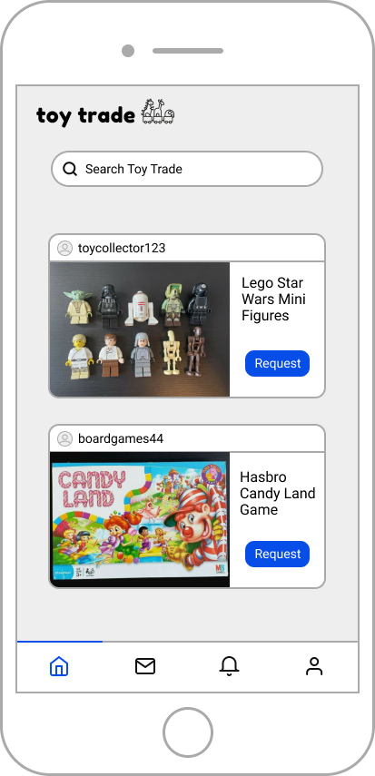
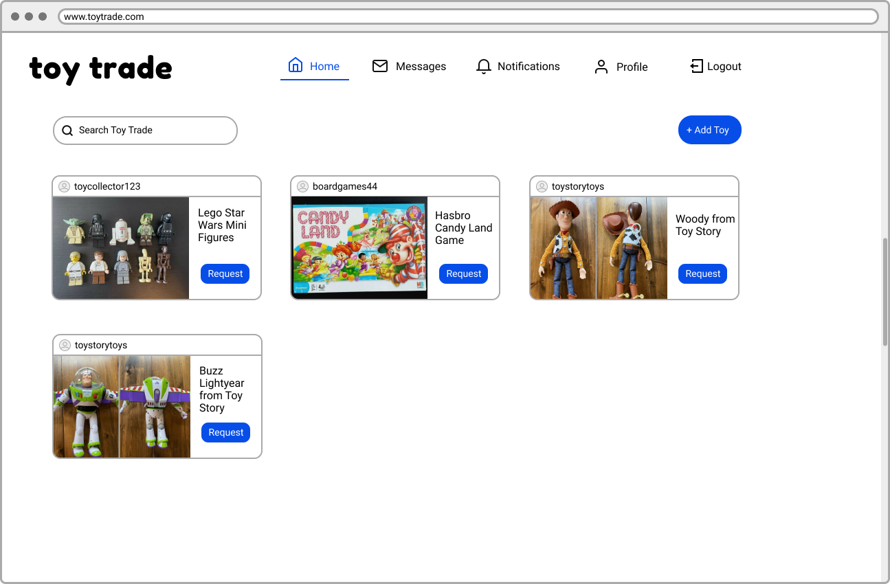
WIREFRAMES
Notes:
Joyce

Slide 10
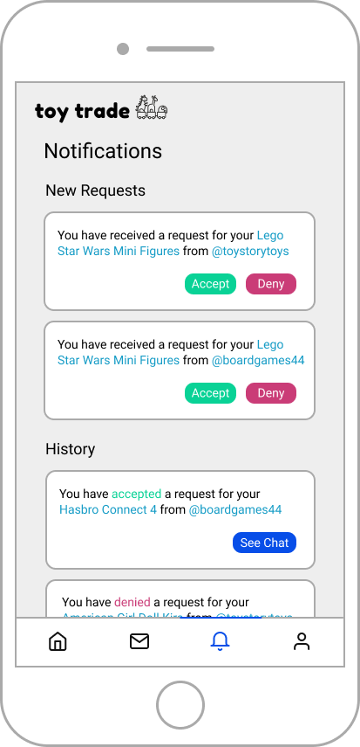
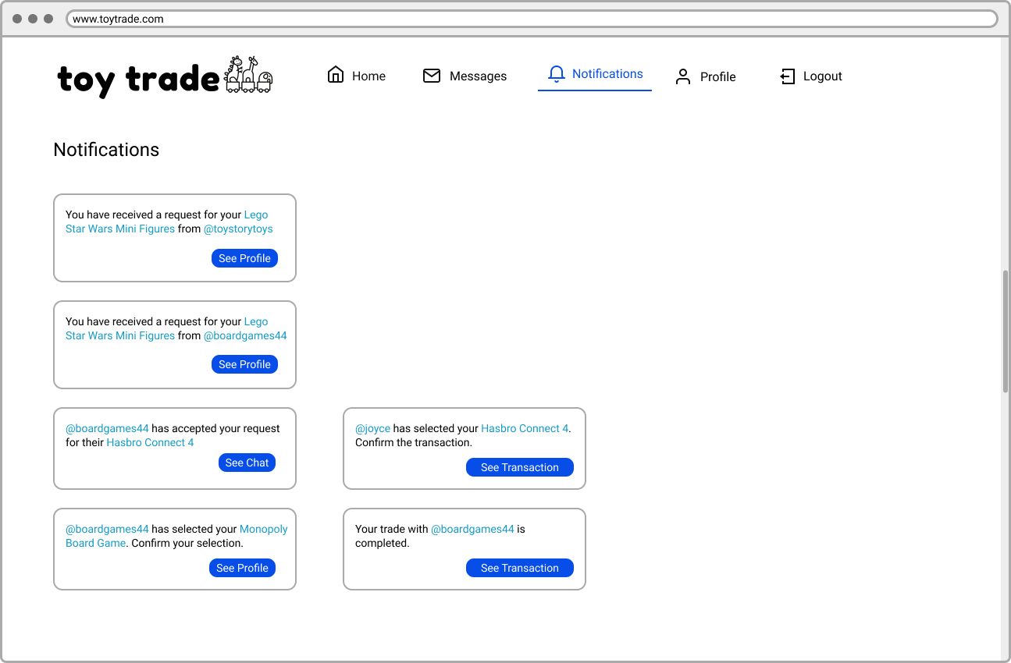
WIREFRAMES
Notes:
Joyce

Slide 11
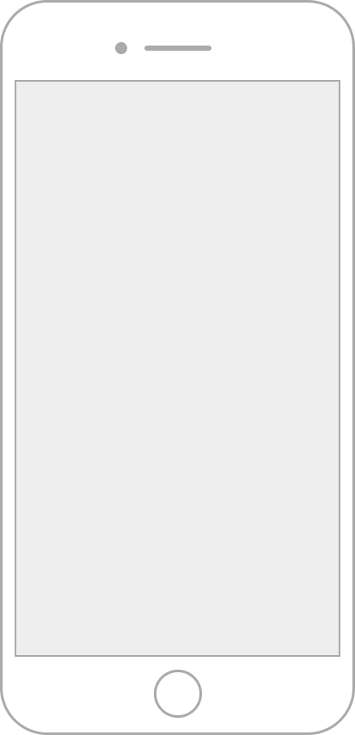
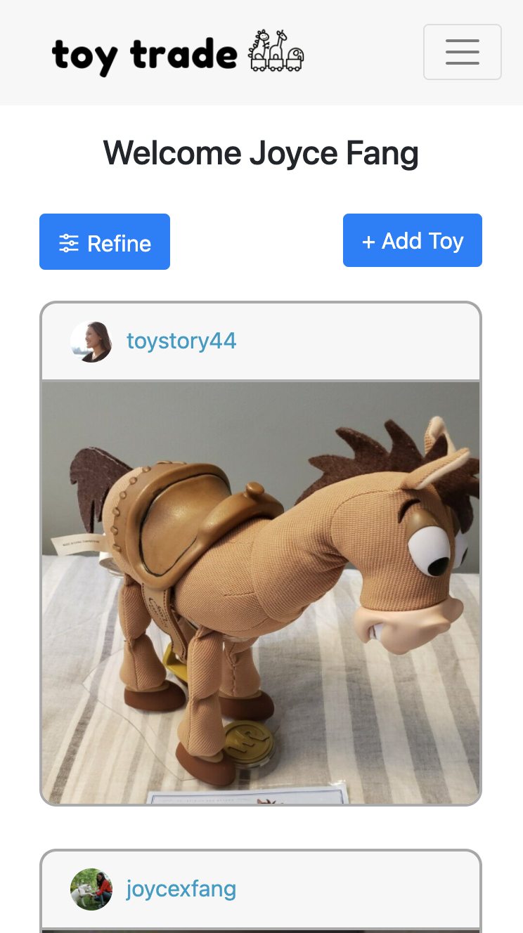
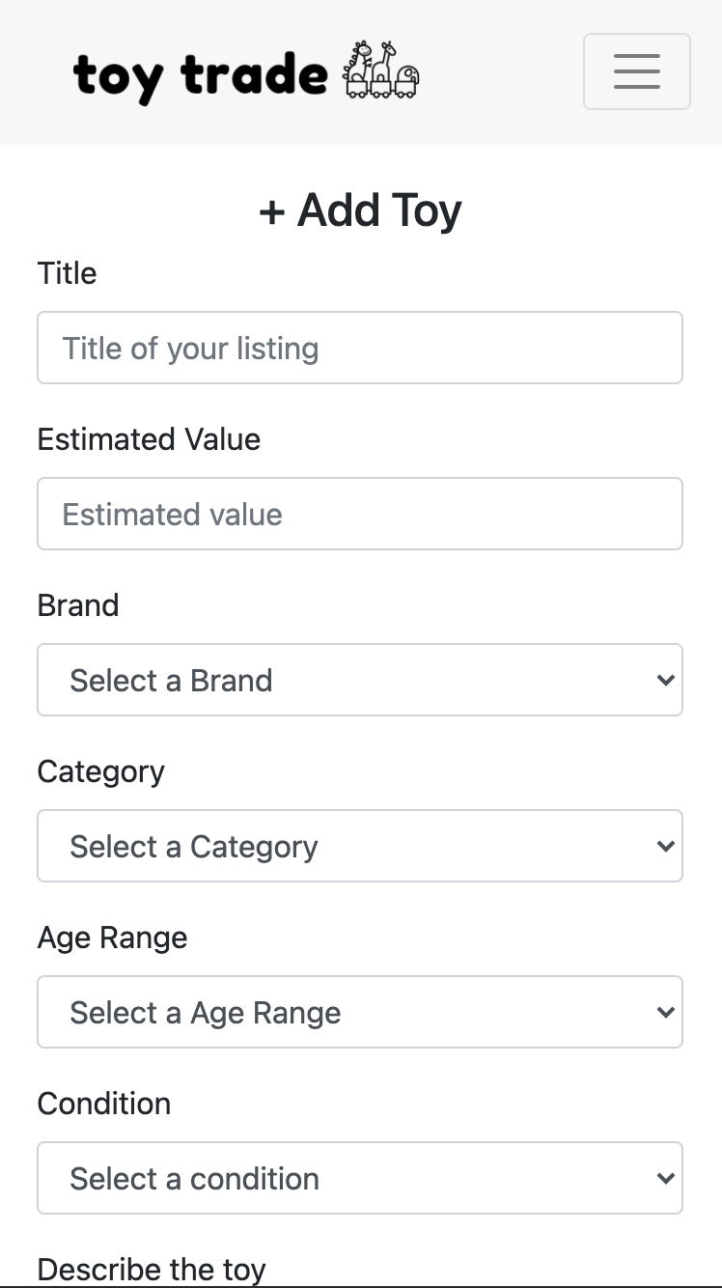
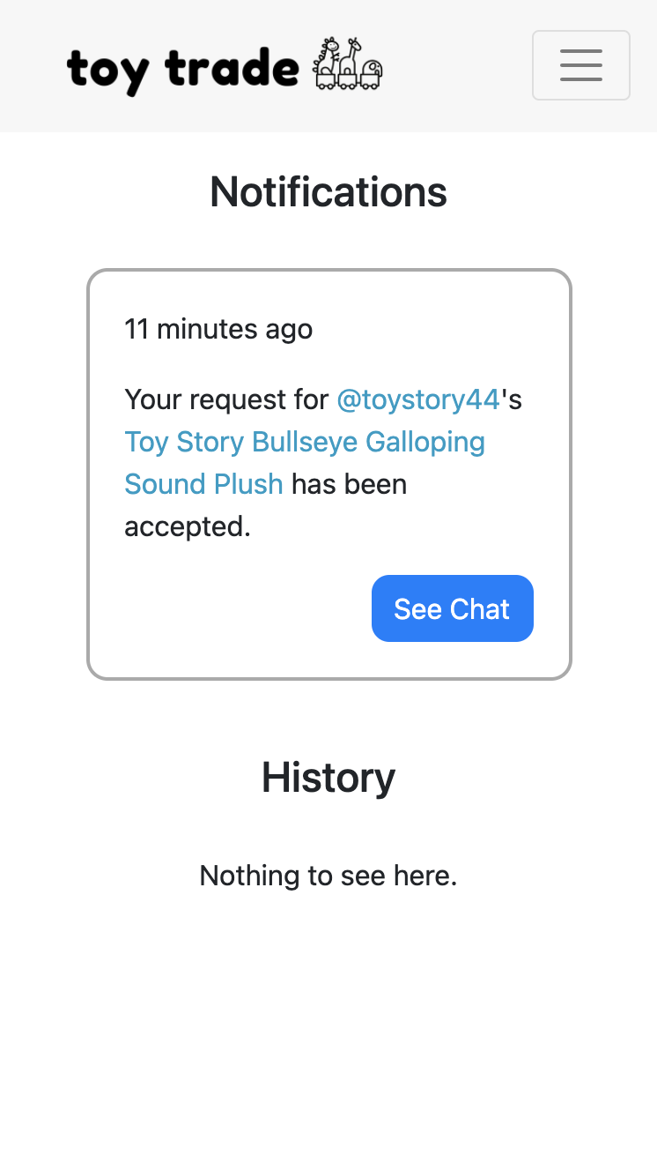
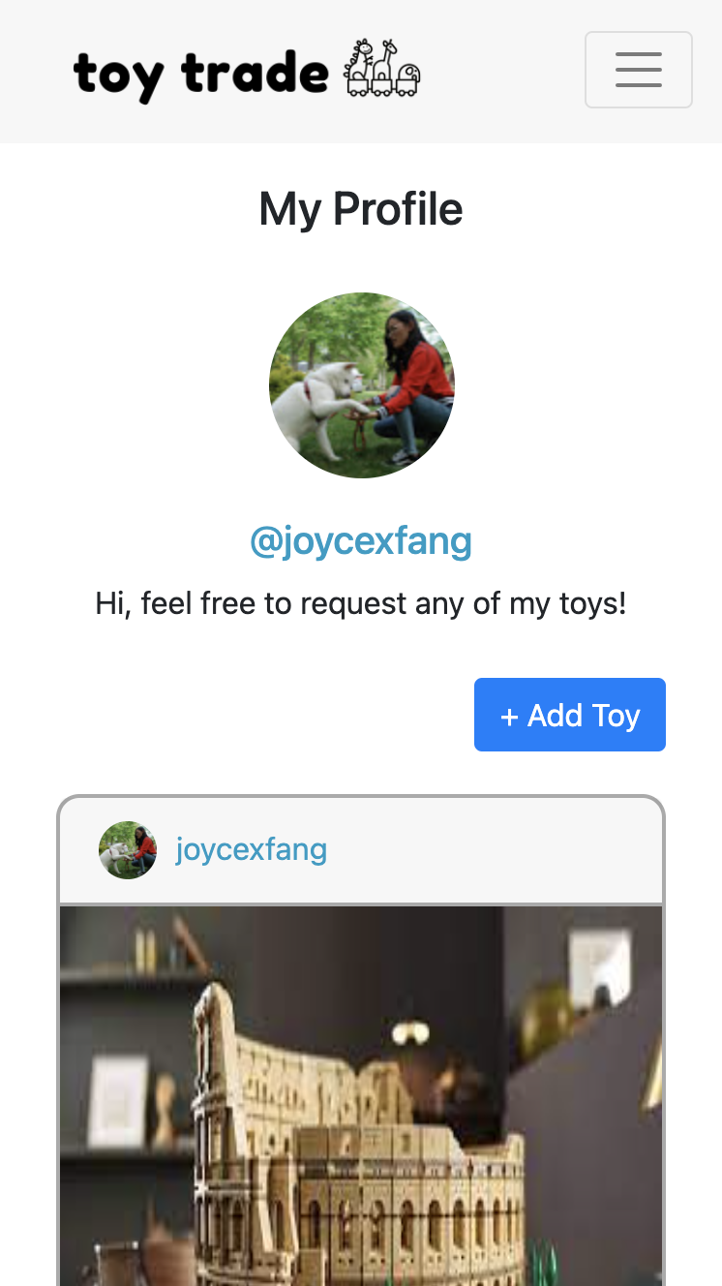
MOBILE DESIGN
HOME
ADD TOY
NOTIFICATIONS
PROFILE
Notes:
Joyce

Slide 12
FILE STRUCTURE
app
core
shared
pages
services
universal
Notes:
Joyce

Slide 13
COMPONENTS AND SERVICES
PAGES
SERVICES
SHARED
Add Toy
Chat
Home
Landing
New User
Notifications
Profile
Profile Viewer
Http
Auth
Dashboard
Login/Logout Button
Add Toy Button
UNIVERSAL
Header
Notes:
Joyce

Slide 14
API REQUESTS
GET/POST
/api/v1/toys
/api/v1/users/:userId
PUT
/api/v1/users/:userId
/api/v1/notifications/archives/:notificationId
Notes:
Joyce

Slide 15
DATABASE SCHEMA
ToyTrade
MessageGroups
Notifications
Users
Messages
Toys
Transactions
Notes:
Jody

Slide 16
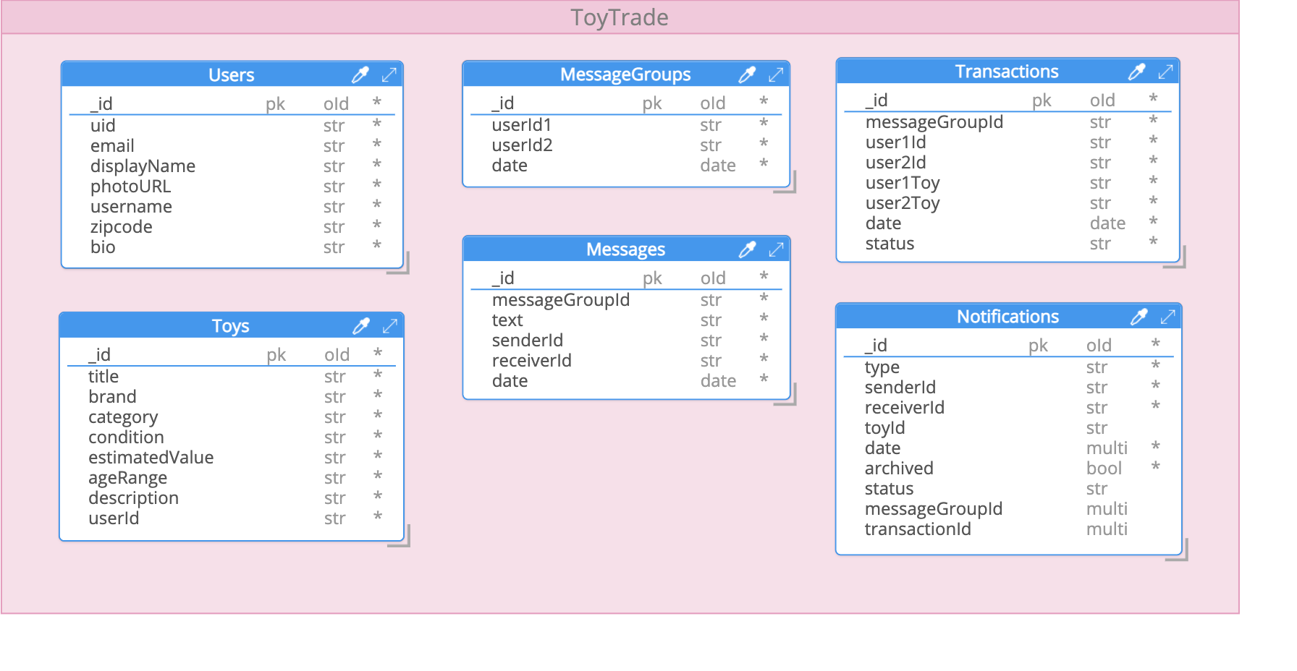
DATABASE SCHEMA
Notes:
Jody

Slide 17
HOW IT WORKS
Start by browsing the home page to view toys listed by other users
If you find a toy you like, you can view more information about it and then request the toy
If your request is accepted, you may chat with the other user
On the chat page, one of the users sets up a transaction
The other user then reviews and confirms the transaction
Then the transaction is complete!
Notes:
Jody

Slide 18
DEMO
Notes:
Joyce and Jody

Slide 19
CHALLENGES
Implementing Google OAuth with Firebase
Uploading toy images and deciding how to store them
Working with Angular forms
Learning how to use Angular Routing
Keeping track of different types of notifications
Notes:
Tyler

Slide 20
MONETIZATION
Sponsored toys
Premium accounts for subscribers
Boosted posts
Affiliate products and links
Trade in program with toy companies
Promote less waste
Display ads
Notes:
Colleen

Slide 21
FUTURE GOALS
Filter toys by zip code
Enable users to edit profile information and toy listings
Use Node.js sockets for messaging
Include a feature where users can trade multiple toys at a time
Complete QR code functionality
Allow users to rate other users based on their experience
Notes:
Colleen

Slide 22
THANKS!
Questions?
Notes:
Colleen

